Slide 1
Surveying Methods and Non-Response Bias
Benjamin Chu
Biomath 204
3/15/2017

Slide 2
Random and convenient sampling
Random – survey a sub-population selected at random
Convenient – sample people who are easy to reach
E.g. volunteer sampling

Slide 3

Data analysis: trash in trash out
Acquiring a good dataset is as important as analyzing them!!
i.e. Must account for sampling errors and various forms of biases.
https://www.youtube.com/watch?v=6v148z4ISIM

Slide 4
What is Non-Response Bias?
Error due particular population not responding to poll
total survey error = coverage error + nonresponse error + measurement error
+ processing error + sampling error
Andersen et al., 1979

Slide 5
Identify and adjust for (unit) nonresponse bias
Identify:
Compare initial and late response
Compare survey results to known population parameter
Using known data base variable to identify bias
Adjust:
Calibration weighting adjustments
Propensity model

Slide 6
4 approaches to mitigate nonresponse bias

Slide 7
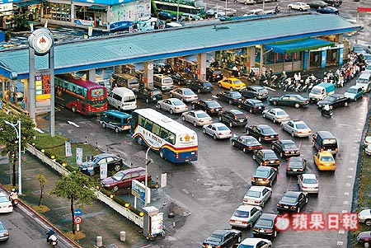
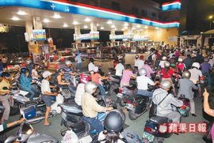
Project motivation
http://enochtsui.pixnet.net/blog/post/22484205
http://web2.yzu.edu.tw/e_news/506/
Q: What are people’s refueling habits?

Slide 8

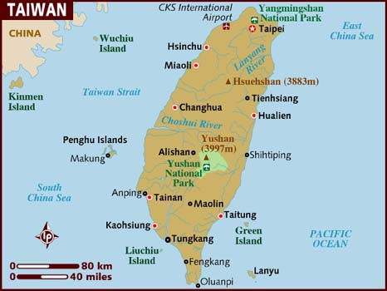
Taiwan and CPC Corp.
Imports >97% gas consumed
CPC distributes >70% of all gas
http://www.lonelyplanet.com/maps/asia/taiwan/

Slide 9
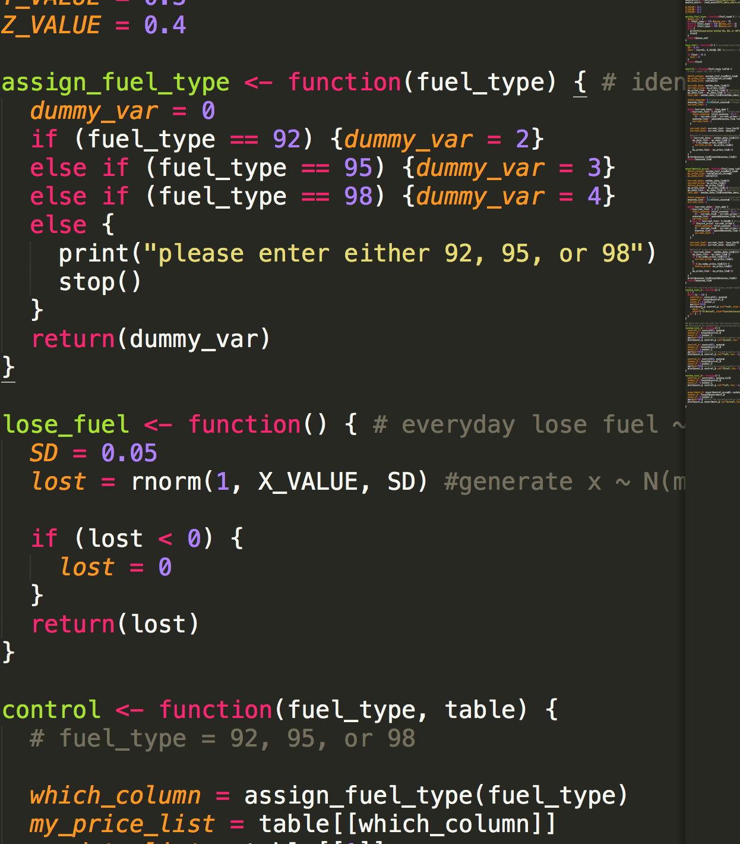
Use survey results in a Simulation
Everyday people lose X% fuel,
X ~ N(10, 5²)
Control group – no refueling strategy
Others – various “simple” strategy

